Slide 1
Network Intrusion Detection
By: Jack Song, Kerry Jones, and Julina Zhang
Advisor: Don Brown, Hyojung Kang
Client: UVA Information Security, Policy, and Records Office
Sponsor: UVA SEAS / Leidos

Slide 2
What is a network intrusion?
•Any unauthorized activity on a computer network
•Compromise and extract sensitive information from a network

Slide 3
Problem and Challenges
•Problem
•Novel intrusion techniques
•Challenge
•No output for comparison
•Abnormal vs. malicious
•Wide range of users and activities
Notes:
there is a diverse range of user, like students, IT professionals,

Slide 4

Why is it important?
Notes:
Networks within organizations need to be open to facilitate the free exchange of information, solving the problem can also bring extra value for the organization.
In Feb 2016, Hackers pentrated SWIFT Bank network. They observred how transfer we done and gained access to credentials for payment transfers. And used these credentials to authorize transfers to accounts in Sri Lanka and the Phillipines.
Transfers were worth up to $851 million dollars, ending up losing about $81 million to Philippines accounts.
Large institutions such as UVA are also vulnerable to security breaches. Hackers and other agents of nefarious activity are constantly trying to breach UVA’s network to obtain valuable sensitive and personal information
Everyone has sensitive information stored in their devices. If we can detect intrusion fast, we can stop it right away and minimize the amount of information leaked out.
Ex: if a hacker successfully gets into the UVA system, we want to stop it as soon as possible so that s/he does not get hold on our information such as our social security numbers.
cost for both false-positive and false-negative are so high.
http://www.reuters.com/article/us-cyber-heist-swift-specialreport-idUSKCN0YB0DD

Slide 5
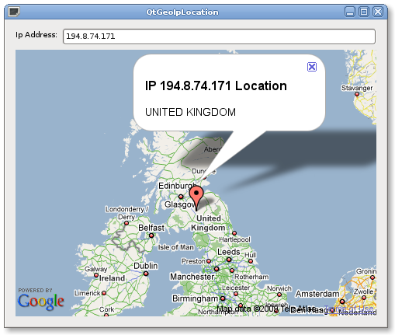


Objective
Our aim is to Detect Intrusions with the UVA network.
Notes:
Detection Intrusion –define it
-Location
-Time
-Size of data transfers
Our aim is to try and evaluate abnormality based on between IP addresses based on three aspects. In no particular order we would like to understand normality in respect to location, temporal and size of data transfer.
By investigating location, we can get a baseline of the most common addresses being IPV4 packets are being sent to.
Type of activity to occur at a given time
Size of typical size of the packets being sent with respect to normal patterns of behavior and occurrence.
Once we established these baselines, we can get idea of abnormal behavior with regards to three aspects.

Slide 6
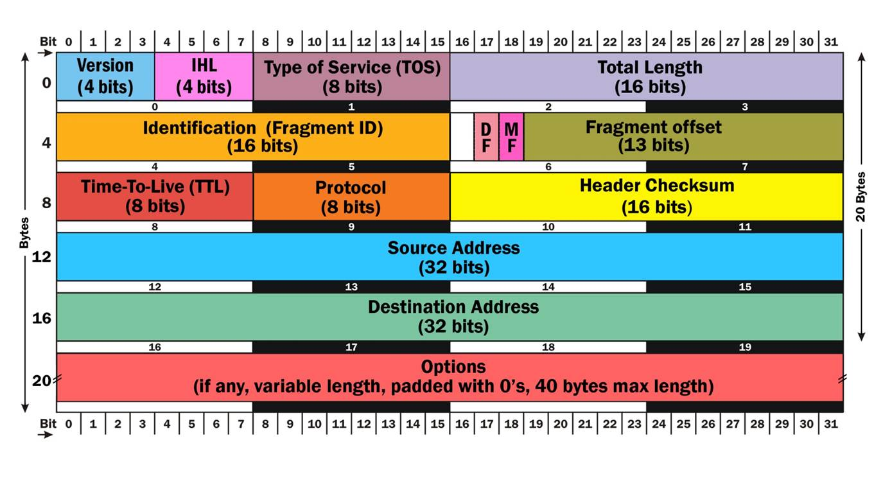
The Data IPv4 Header
Notes:
For our investigation are primarily interested in extracting information from IPv4 Network Packet headers. IPv4 is a common internet network protocol. An IP Address is data structure understood by a network which uniquely define a recipient end points with a network.
Most people are familiar with the idea of a postal address that allows a postman to find a person's house; a computer processor may use a memory address to uniquely identify a location in memory.
Similarly think of The IPv4 packet header as a mailing envelope:
Where its coming from/to
Don’t know what’s in the file but have an idea of how large the packet is based on the size.

Slide 7
The Data IPv4 Header
Notes:
We will look at the Source and Destination and Total Length
For our investigation are primarily interested in extracting information from IPv4 Network Packet headers. IPv4 is a common internet network protocol. An IP Address is data structure understood by a network which uniquely define a recipient end points with a network.
Most people are familiar with the idea of a postal address that allows a postman to find a person's house; a computer processor may use a memory address to uniquely identify a location in memory.
Similarly think of The IPv4 packet header as a mailing envelope:
Where its coming from/to
Don’t know what’s in the file but have an idea of how large the packet is based on the size.
We will look at the Source and Destination and Total Length

Slide 8
Source IP
Destination IP
transmission
Notes:
Create one source -> destination pair
Fill the space with many such pairs
Subset such pairs with UVA network IP domain
Converge on destination pairs
Add clusters

Slide 9
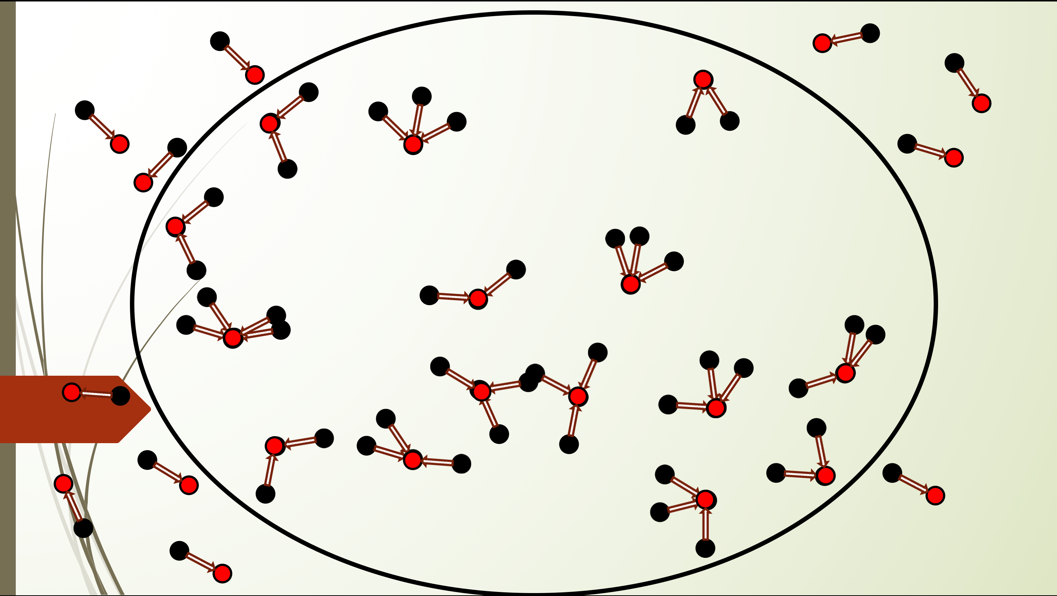

Slide 10
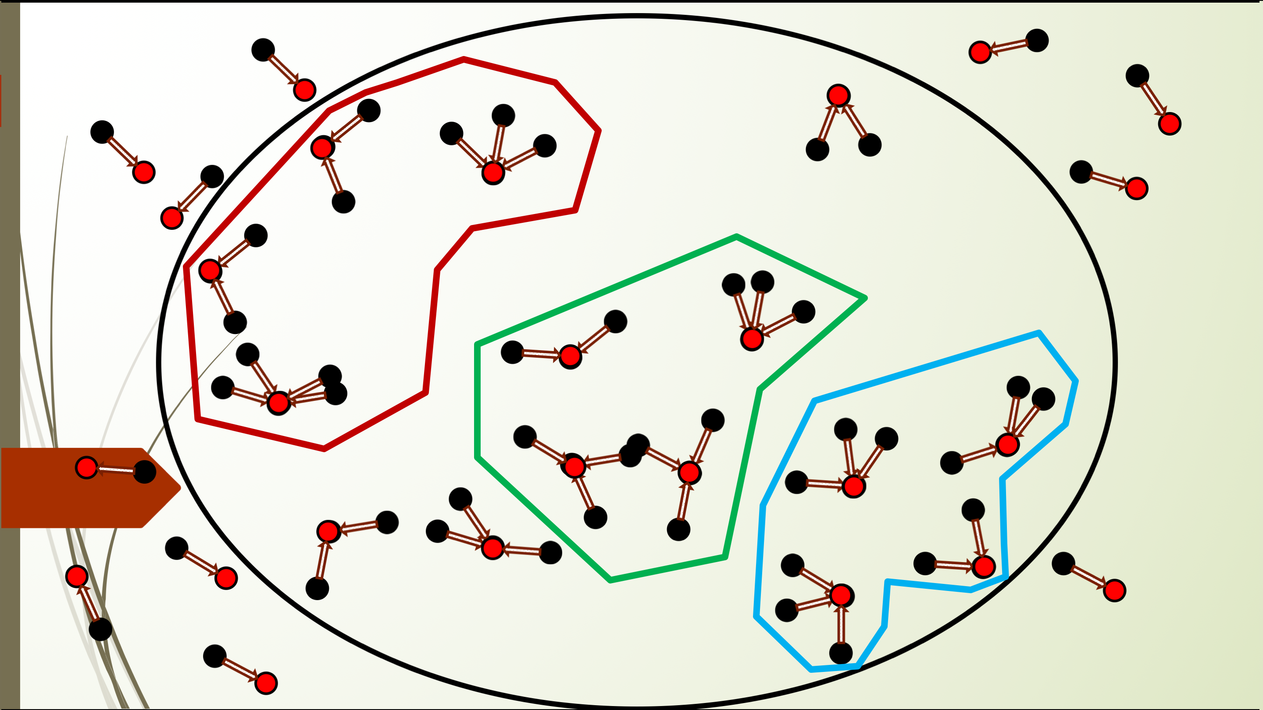
Abnormality!

Slide 11
Deliverables, benefits, next step
Our final data product will be a black box.
This product will aid Uva network security faculties in their job.
To achieve our goal, we will build a prototype and make it better iteratively.
Notes:
The final data product will be a black box that classifies input data based on the way that data is leaving uva network. At the same time, both statistical and common-sense interpretation will be provided so that clients with different background can use our product in a way that suits them best.
Cost of false-negatives are high due to the sensitive nature of the problem, to have a better understanding from a different standpoint (in our case, looking at data leaving uva) can be useful. Ideally, our data product should help decision makers to quickly impede suspicious activity from happening with acceptable cost (interrupting the user experience of a member of the university vs. having sensitive information stolen).
Next steps include:
to parse net flow packet headers using wireshark
establish preliminary models and evaluate model performance so that decision can be made on what model to use
iteratively evaluate current methods and revise/improve when significant difficulties are encountered, or surprising results occur.

Slide 12
Wireshark
AWS
S3, EMR
Hadoop, HDFS

Slide 13
